Slide 1




Slide 2

EXECUTIVE SUMMARY
Executive summary
WHERE EVENTBRITE STANDS TODAY
WHAT EVENTBRITE GETS WITH YUNO
A new chapter
Eventbrite operates since March 2026 as part of Bending Spoons, with a lean operating model and a new commerce leadership team.
PAY-IN AND PAYOUT ROUTING IN ONE LAYER
Both sides of the marketplace orchestrated, with the ledger that links every pay-in to its payout.
The decision on the table, now
Whether to bring in an orchestration layer, with an active evaluation of several orchestrators.
Direction already set
The team has aligned on a multi-PSP strategy over consolidating into a single processor.
MODULAR BY DESIGN
Activate only what you need. Every provider you run today stays.
Open fronts the decision must resolve
Intelligent routing across the existing rails, including the ChaseNet economics offered by J.P. Morgan, the exit from own LatAm entities, getting out of the funds flow with PSD3 on the horizon, and running all of it with a small team.
TOP 10 OPERATING COUNTRIES, OF 122 TOTAL
United States, United Kingdom, Canada, Australia, Italy, Germany, Spain, Ireland, France and Mexico. The weight sits in the US and Europe, with Mexico as the only LatAm market in the top 10.
ONE DASHBOARD
Normalized data and automatic reconciliation across every rail.
2

Slide 3
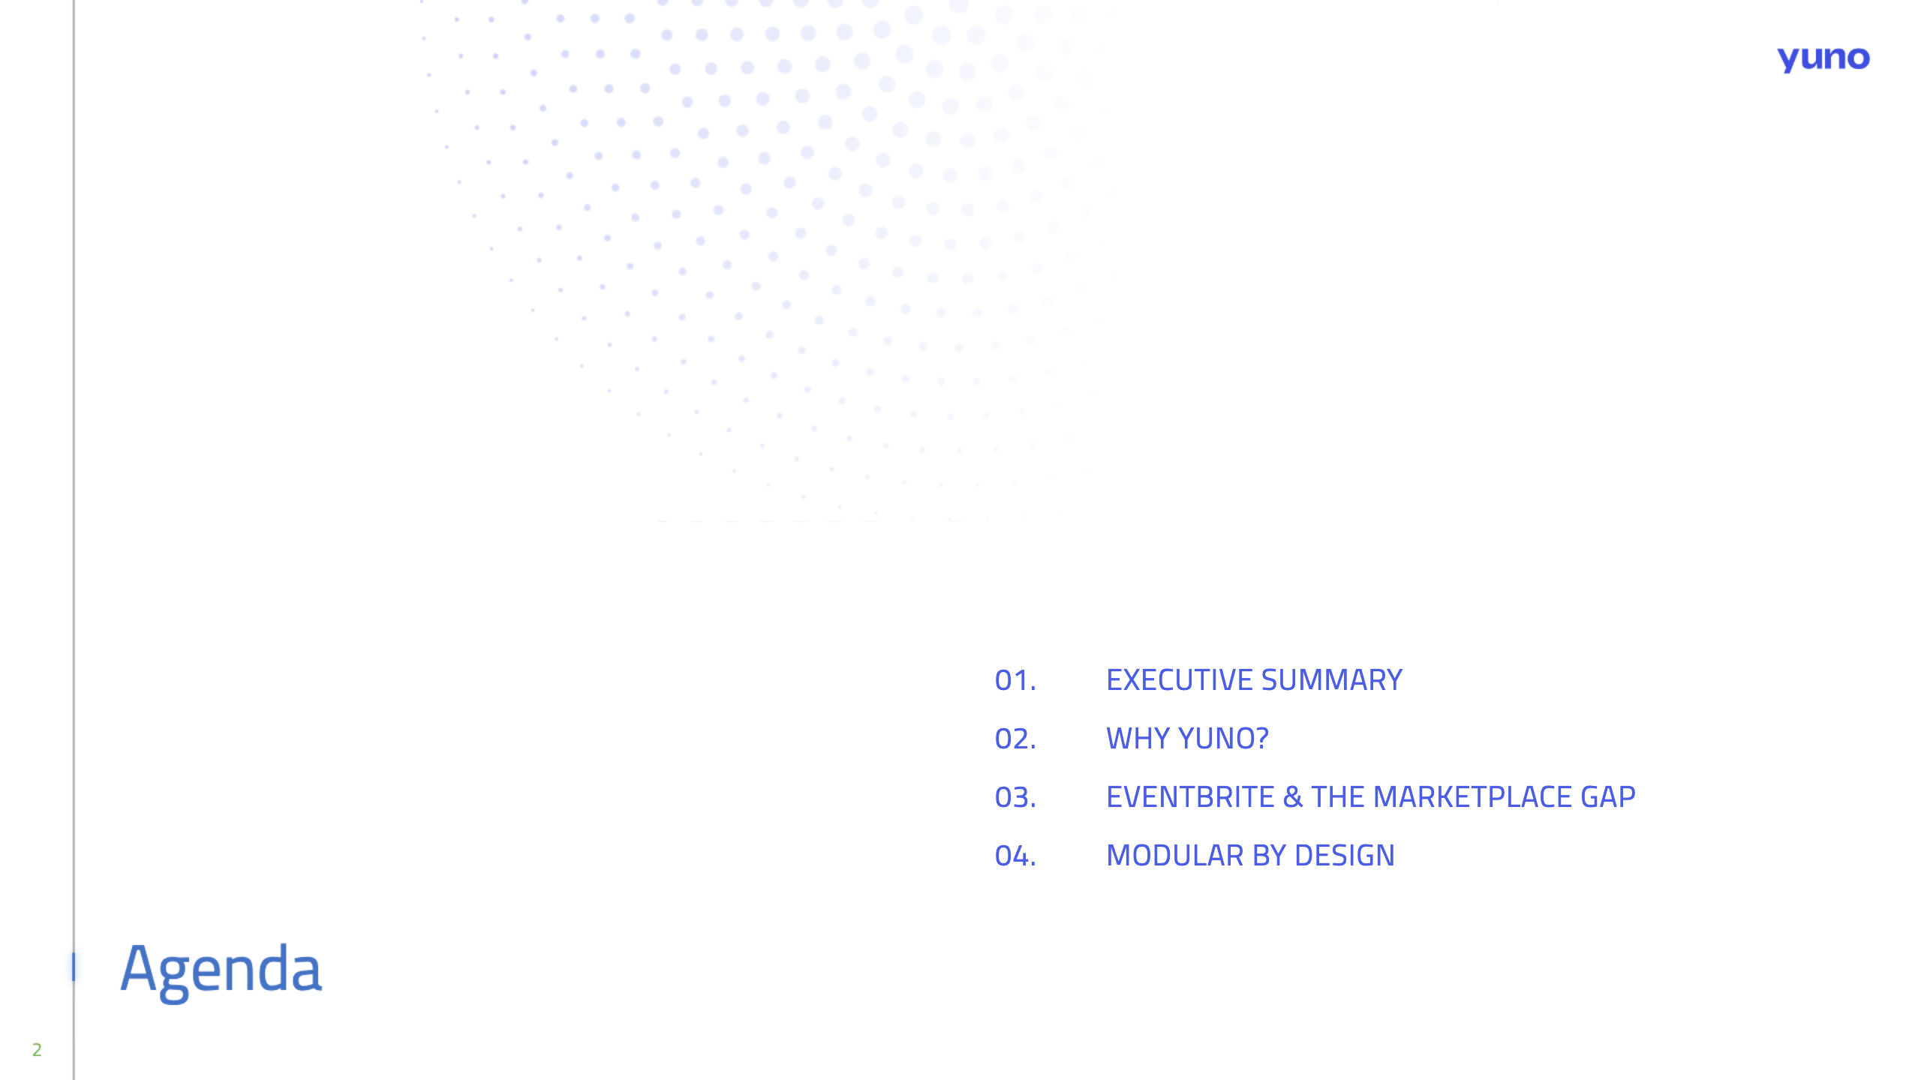
01.
EXECUTIVE SUMMARY
02.
WHY YUNO?
03.
EVENTBRITE & THE MARKETPLACE GAP
04.
MODULAR BY DESIGN
05.
THE PATH FORWARD

Slide 4
Why Yuno?
AGENDA

Slide 5
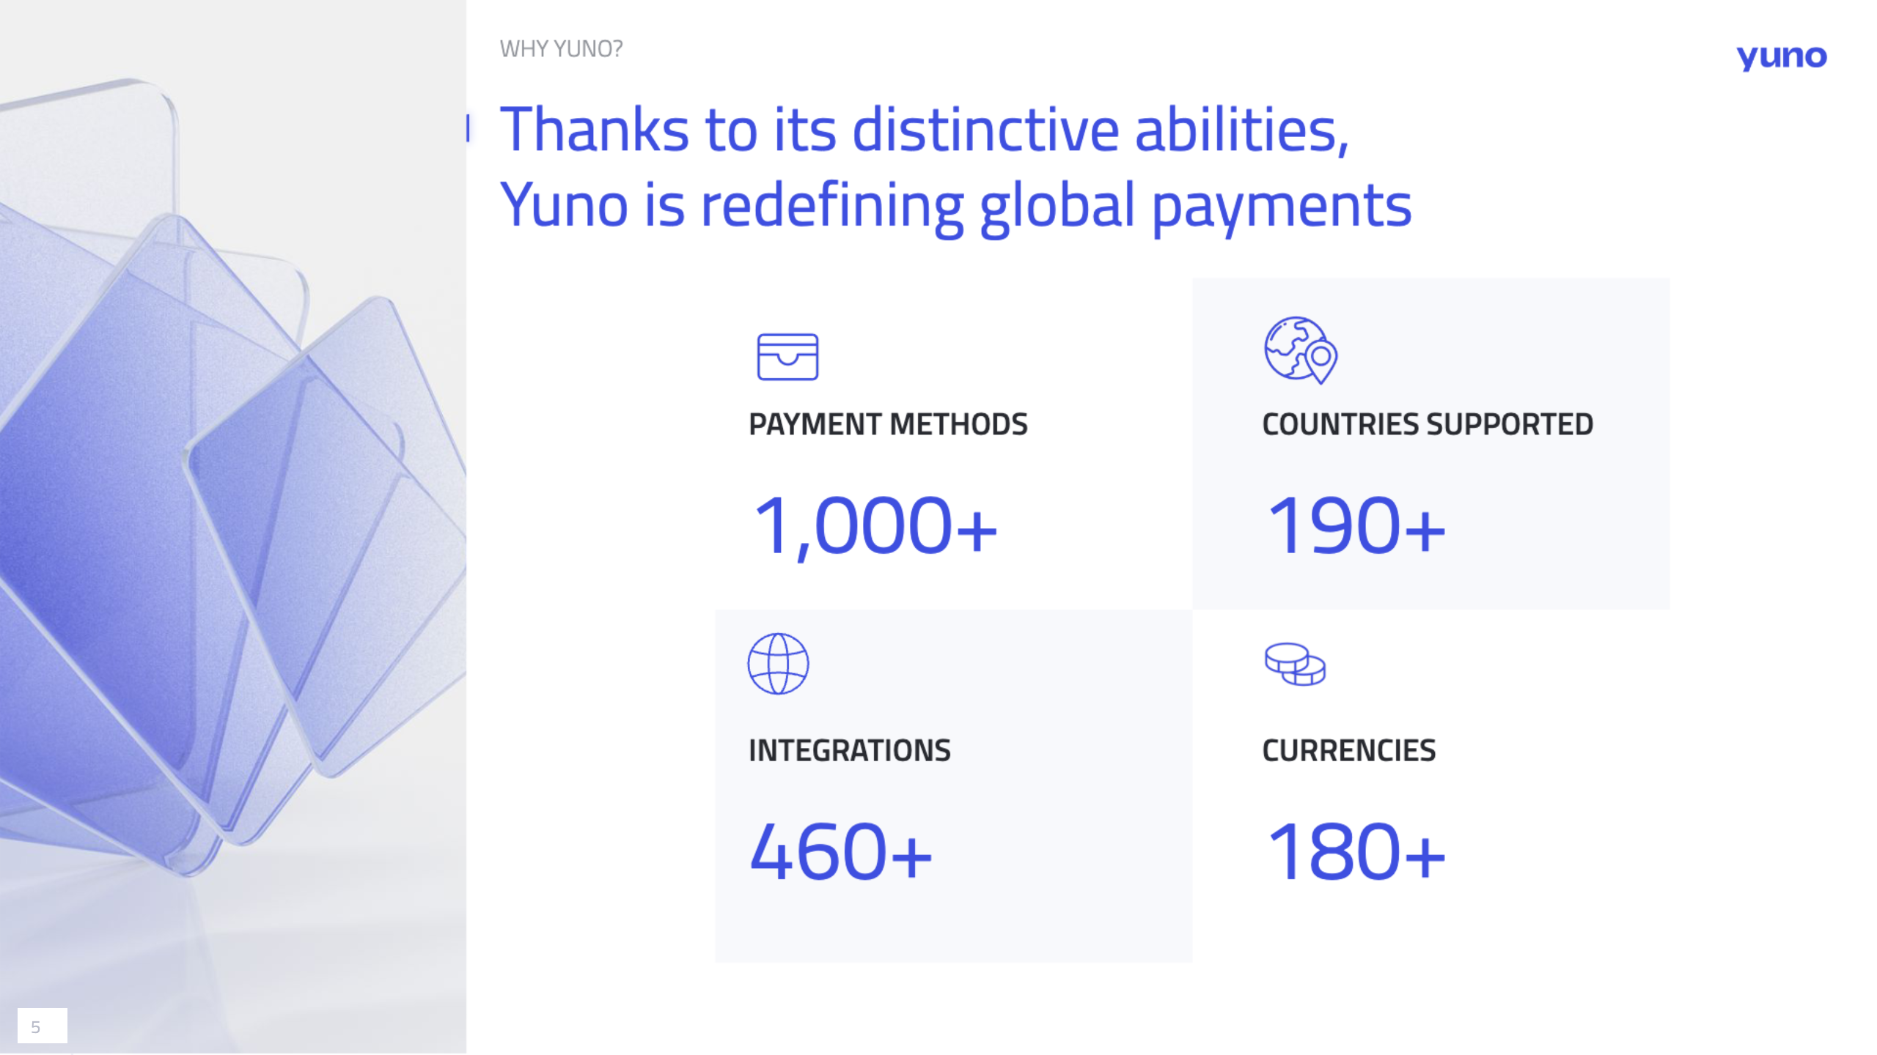
5

Slide 6
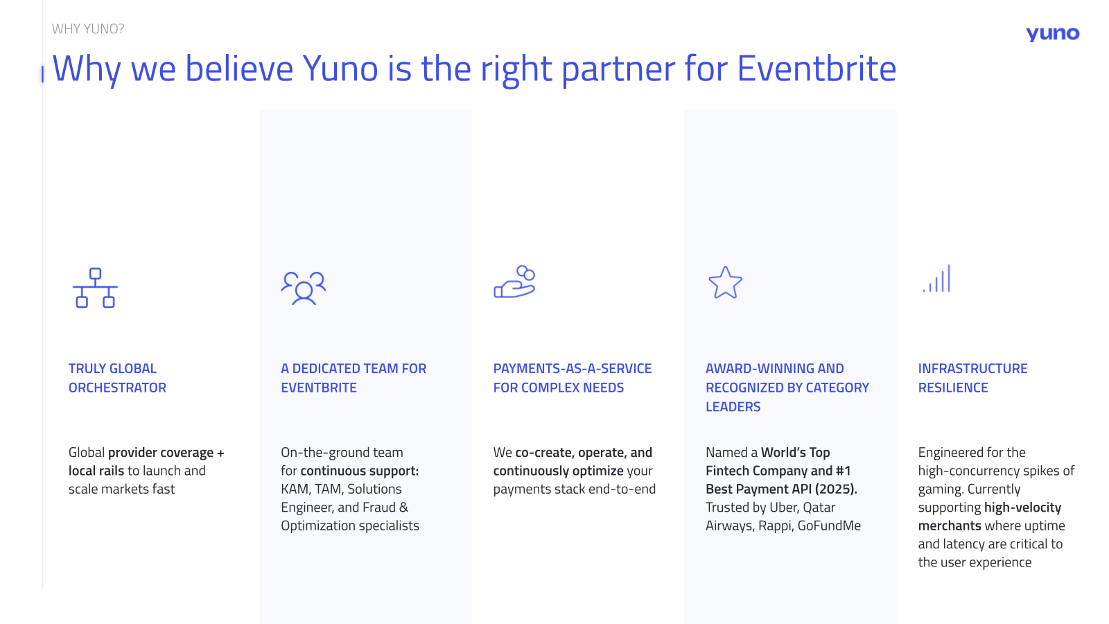

Slide 7
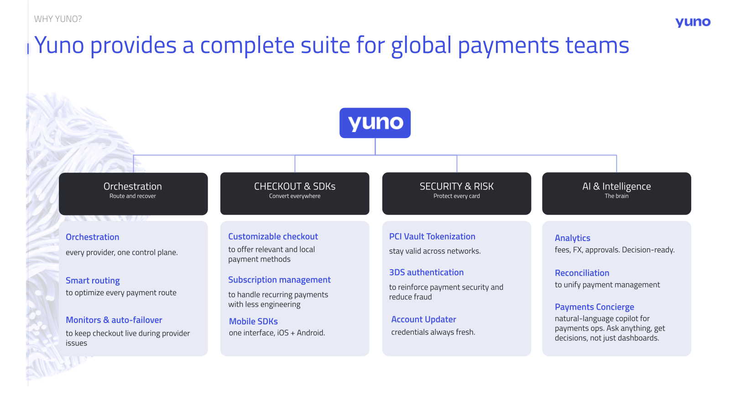

Slide 8
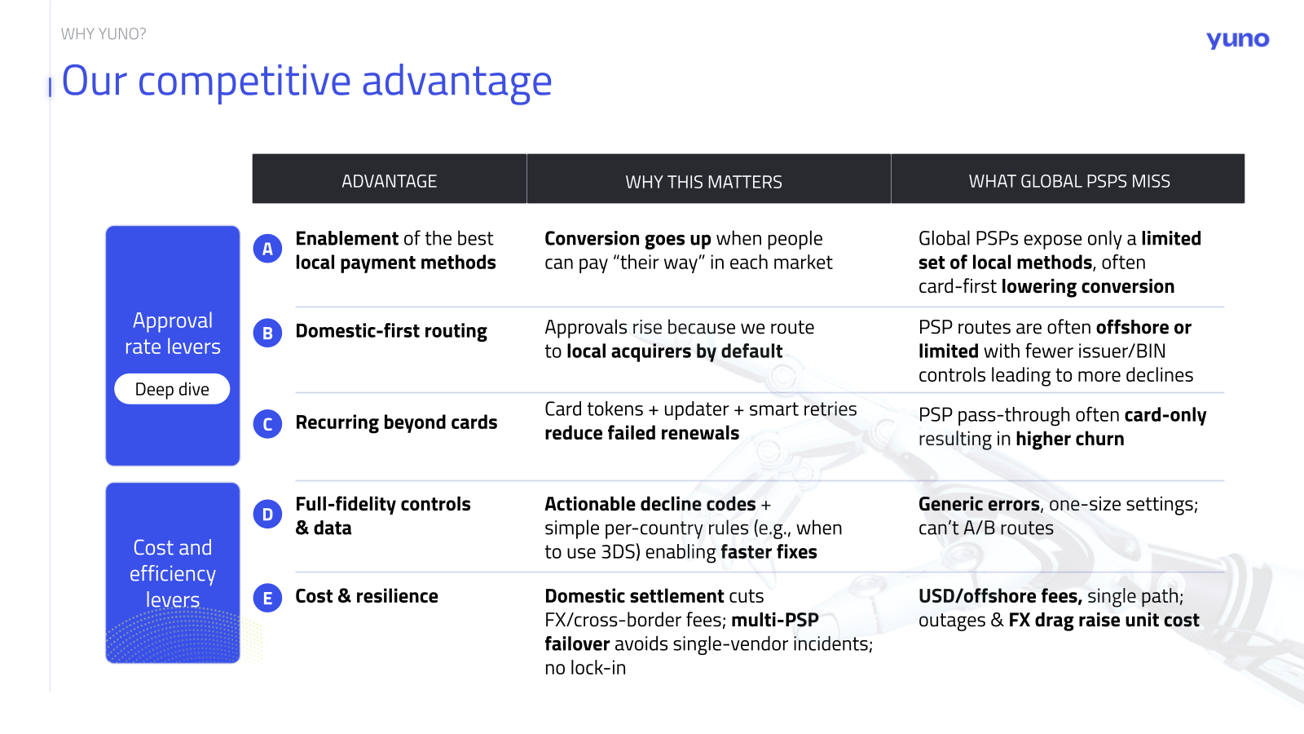

Slide 9
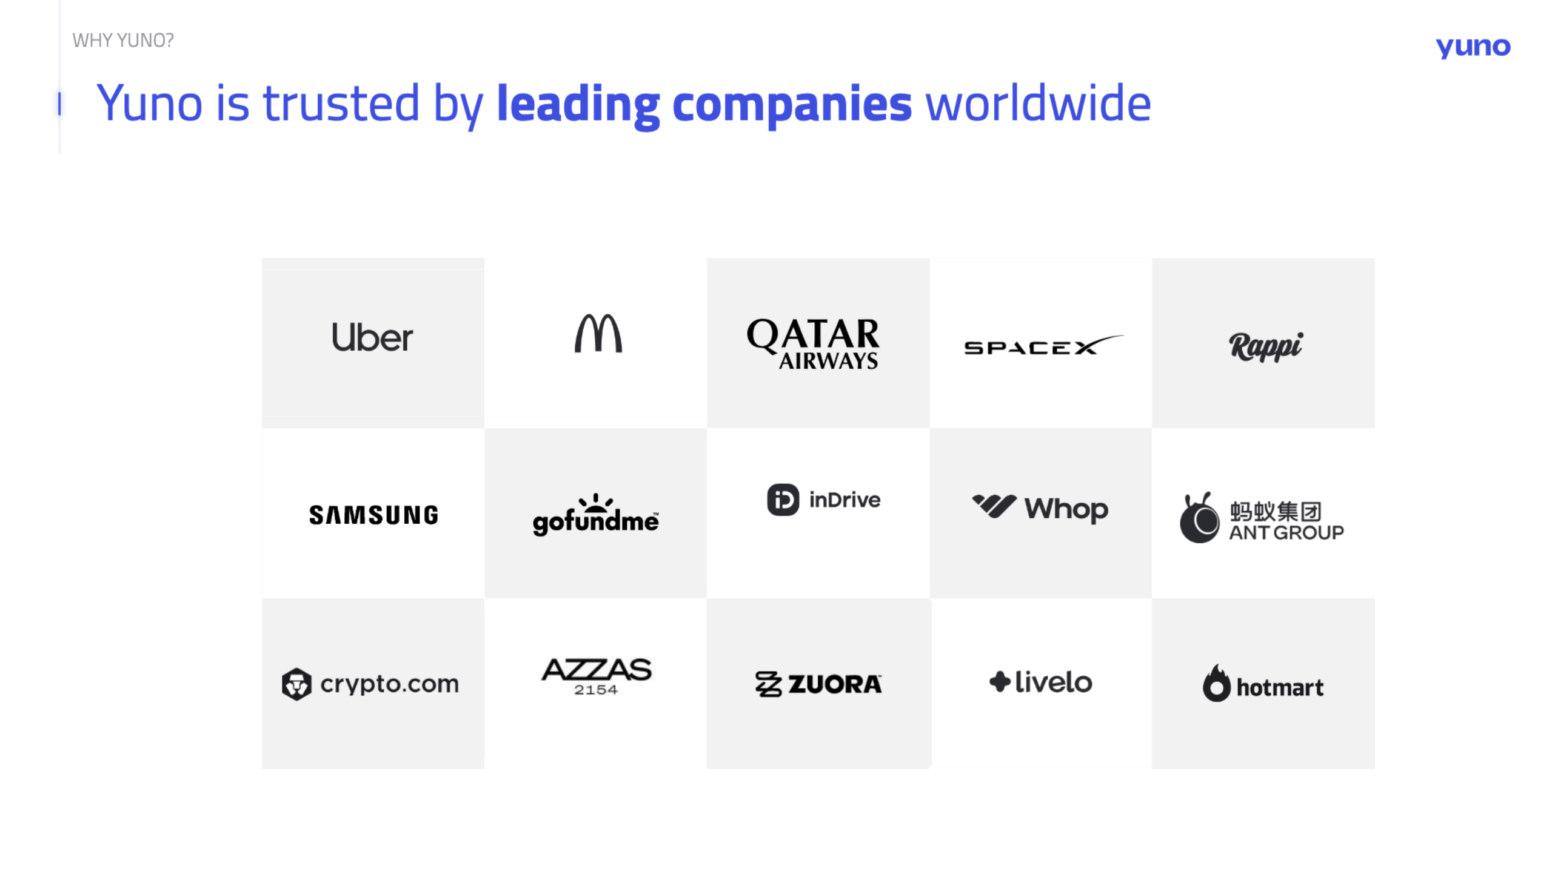

Slide 10
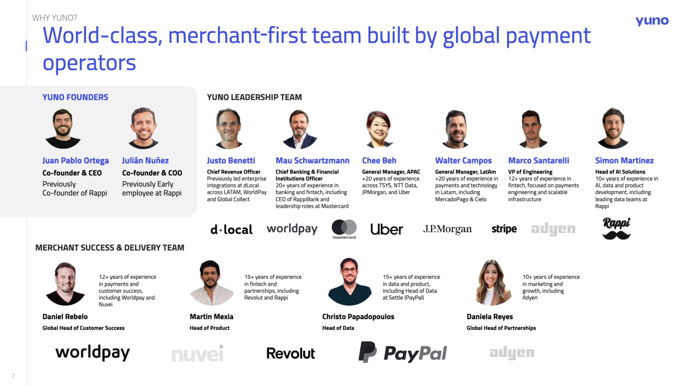
10

Slide 11
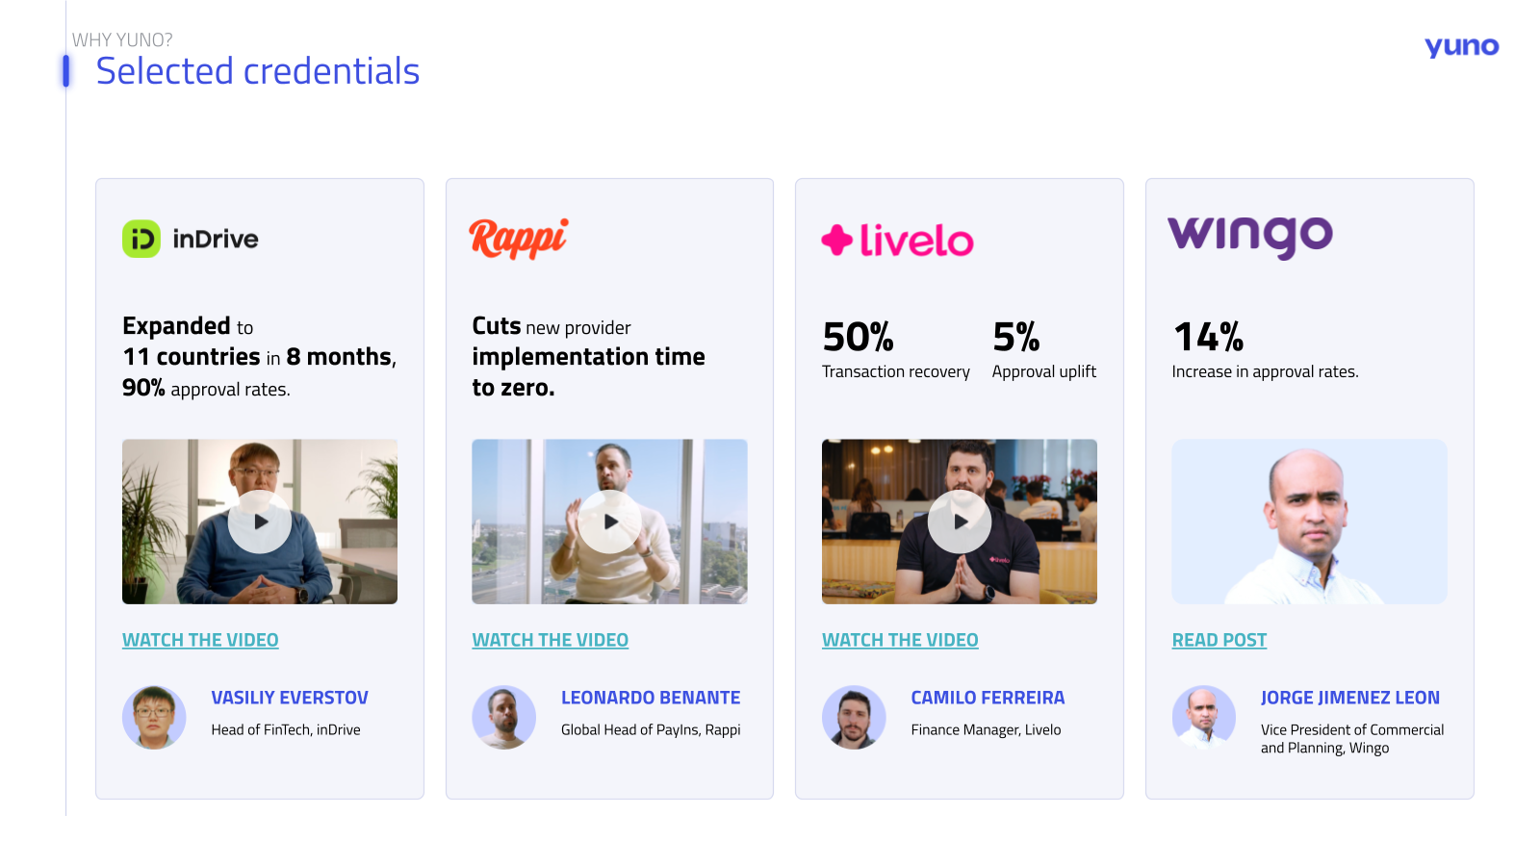

Slide 12
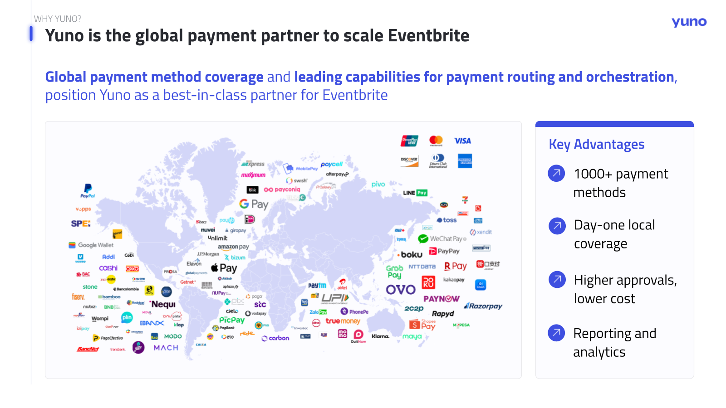

Slide 13
Eventbrite & the marketplace gap
AGENDA

Slide 14
EVENTBRITE & THE MARKETPLACE GAP
Eventbrite's payment stack today
IN THE TEAM'S OWN WORDS
THE RAILS RUNNING TODAY
No routing between rails
↗
Stripe
No cross-processor failover, no BIN-based routing, no least-cost debit routing running today.
↗
Braintree
↗
J.P. Morgan Chase
One portal per provider
Reporting lives in each provider's own dashboard.
↗
Wells Fargo
↗
Mercado Pago
Creators coupled to one rail
↗
Adyen
Onboarding is tied to the processor; cross-currency events can trigger double FX and re-onboarding.
Entities under review
Own entities operate Brazil, Argentina, Mexico and Colombia; the team is evaluating an exit from the funds flow.
6
rails integrated point to point, with no routing layer between them.
14

Slide 15
EVENTBRITE & THE MARKETPLACE GAP
The gap nobody closes
"There are great orchestrators for pay-ins, decent ones for payouts, and no one has tied the two together."
Heard repeatedly across the industry
MATURE CATEGORY
THE GAP
CAPABLE, BUT BLIND
Pay-in orchestration
The connecting layer
Payout providers
Routing, retries, tokenization, checkout. A crowded field.
↗
KYC & KYB of creators
Strong rails, disconnected from the money coming in.
↗
Funds, ledger and reserves
↗
FX across both sides
↗
Reconciliation end to end
↗
Fraud signals spanning pay-in and payout
Attendee side only.
This is where marketplaces live.
No view of the pay-in side.
100s
of payments engineers run this middle layer at Uber and Amazon. A company built to operate lean needs it as a service, not as an org.
15

Slide 16
Modular by design
AGENDA

Slide 17
MODULAR BY DESIGN
A modular operating system for payments
EVENTBRITE
ONE API · ONE CONTRACT · ONE DASHBOARD
YUNO OPERATING SYSTEM
Every module activates standalone. Every module works with every provider below.
Pay-in orchestration
Payouts
KYC & KYB
Fraud
Routing and retries
Creator disbursement
Portable onboarding
Both sides of the loop
Reconciliation
Tokenization
MoR partner network
One ledger across rails
PSP-agnostic vault
Local entities on tap
PROVIDER LAYER
Stripe
Braintree
J.P. Morgan
Adyen
Mercado Pago
dLocal
Cybersource
460+
integrations
Adding or swapping a provider is configuration, not a build. Nothing obliges you to take the bundle.
17

Slide 18
MODULAR BY DESIGN
Bundle lock-in vs modular freedom
THE BUNDLE MODEL
THE MODULAR MODEL
CREATOR ONBOARDING
KYC locked to the platform account
Onboarded once, portable KYC & KYB owned by you
PROCESSING
Same rail only, no alternative route
Best route per transaction across every connected provider
PAYOUT
Bound to country and currency
Best provider per payout, one ledger as source of truth
CROSS-CURRENCY EVENTS
FX paid twice
FX quoted once, on the winning rail
COST OF SWITCHING
Leaving means re-onboarding every creator
Swap any piece without touching the creator
The platform products use the same underlying KYC and payout providers you can use standalone. Modularity returns that choice, and its economics, to you.
18

Slide 19
MODULAR BY DESIGN
Pay-in routing, as deep as you want it
THE ROUTE DECISION
BIN lookup on every transaction
SMART RETRY ECONOMICS
Retry only when the expected recovery beats the scheme fees, rule based per decline code and market.
Chase-issued card → ChaseNet
⚠ VERIFY
On-us acquiring, discounted economics.
US debit → least-cost debit rails
⚠ VERIFY
INTERCHANGE+ VISIBILITY
Star, Pulse, NYCE.
Transaction-level data surfaces downgrades and downgrade patterns.
Everything else → best route by cost and auth rate
DOCUMENTED TODAY
On decline, cascading by outcome: chained steps for Succeeded, Pending, Declined and Error.
·
Condition-based routes: card type, amount, currency, payment origin, BIN range
·
Smart Routing AI optimizing conversion rate and costs, or conversion rate and latency
·
Percentage splits across connections for partial manual control
·
Risk profiles as gates inside the route: fraud screening, 3DS, authentication, block and allow lists, velocity rules
·
Post-authorization steps for risk review or settlement, plus no-code rule editing on published routes
Start with a simple cost-and-auth route across the six rails you run today, then add BIN-level logic market by market. Depth is optional.
⚠ VERIFY marks claims pending internal confirmation before this deck is sent.
19

Slide 20
MODULAR BY DESIGN
Payout routing, the same discipline on the other side
STEP
01
STEP
02
STEP
03
Payout request
KYC & KYB gate
Provider selection per payout
Raised the moment the event settles, or on the creator schedule.
Beneficiary verified once, then reused across every payout.
Payout routing selects the provider per market and method, with no limit on the number of records in a request.
EXIT RAILS
RAIL A
A
RAIL B
B
RAIL C
C
Local bank transfer
Card payout via Referenced Payouts
Wallets
Directly into local bank accounts in the preferred currency.
Pays out to the card used in the original payment by referencing that transaction, so the merchant never handles card data .
Where the creator base already holds balances.
Real-time payout status and notifications across providers.
20

Slide 21
MODULAR BY DESIGN
Split marketplace payments, native
ON THE PAYMENT
01
ON THE RECIPIENT
02
ON THE LIABILITY
03
Split among recipients
Recipient onboarding
Liability per recipient
Manual or automatic: percentage, fixed, or mixed.
Each recipient onboarded with dynamic KYC & KYB workflows.
Processing fees and chargebacks assigned to merchant, recipient, or shared.
OUTSIDE THE PAYMENT CYCLE
WHY IT MATTERS FOR EVENTS
Standalone transfers from the organization balance
Multi-organizer events, venue and promoter cuts, and service fees stop being reconciliation work after the fact. The split is part of the transaction.
Advances, adjustments and corrections do not have to wait for a payment to settle.
Yuno orchestrates the split; the provider processes it. Splits run on providers that support them, such as Stripe, Adyen and dLocal.
21

Slide 22
MODULAR BY DESIGN
The marketplace loop, closed
YUNO LEDGER
PAYOUT
PAY-IN
Every pay-in linked to its payout, at transaction level
Best provider per payout, per market
ATTENDEE
Best route per transaction
CREATOR
Stripe · Braintree · J.P. Morgan · Adyen
Bank, card or wallet · local payout partners in 100+ countries
KYC portable
·
Reserves managed
FRAUD SIGNALS ACROSS BOTH SIDES
The fake-event collusion pattern a pay-in-only tool cannot see: a fraudulent pay-in and the payout it funds are two halves of the same signal.
One risk view, pay-in to payout
One API
centralizes pay-ins and payouts on the same platform, so the two sides of the loop share one integration, one ledger and one dashboard.
22

Slide 23
MODULAR BY DESIGN
Exit LatAm entities without exiting LatAm
BRAZIL
ARGENTINA
MEXICO
COLOMBIA
TODAY
Own entity, own compliance and funds flow
Own entity, own compliance and funds flow
Own entity, own compliance and funds flow
Own entity, own compliance and funds flow
WITH YUNO
MoR partner in country , local pay-ins netted against payouts
MoR partner in country , local pay-ins netted against payouts
MoR partner in country , local pay-ins netted against payouts
MoR partner in country , local pay-ins netted against payouts
PARTNER NETWORK
⚠ VERIFY
SCOPE
OPERATIONS
85+
Fully modular
One reporting layer on top
Full MoR, or tax-of-record plus standalone components, staged market by market.
Operations see one normalized dashboard, never another portal.
MoR providers, ranked per market
EBANX connected direct, dLocal and local specialists where they win.
⚠ VERIFY marks claims pending internal confirmation before this deck is sent.
23

Slide 24
MODULAR BY DESIGN
One dashboard, every rail
TODAY
THE LAYER IN BETWEEN
THE RESULT
One portal per provider
Normalization + reconciliation
One dashboard
Stripe portal
Transaction reports and settlement reports, cross-referenced automatically across every provider.
Payment ops, chargebacks and refunds in one place.
Braintree portal
J.P. Morgan portal
Mercado Pago portal
MoR partner portal
Drill into a provider portal only on a flagged discrepancy, with exact references.
Raw data always accessible underneath.
~100
markets with their own entities at Starlink. Before Yuno, one dashboard per acquirer. Today, everything through one.
⚠ VERIFY
⚠ VERIFY marks claims pending internal confirmation before this deck is sent.
24

Slide 25
MODULAR BY DESIGN
Out of the funds flow, in stages
01
STAGE 2
02
STAGE 3
03
STAGE 1
Fast fix
Unbundle
End state
A local MoR partner takes the funds flow per market, entities wind down.
KYC, tax and payout run as separate modules, best provider on each, economics visible per component.
Fully out of the funds flow, no PSP or MSB registration, PSD3-ready in Europe and the UK, Canada-compliant by design.
RELIEF PER MARKET
COST TRANSPARENCY
REGULATORY HEADROOM
The agent exemption is narrowing in Europe and mostly gone in Canada. This structure is staged so the value lands before regulation forces the change.
25

Slide 26
The path forward
AGENDA

Slide 27
THE PATH FORWARD
Built for the Bending Spoons operating model
01
M&A
02
TEAM
03
PORTFOLIO
One layer, both models
Acquisitions land as configuration
Experts on tap
The only marketplace in a portfolio of subscription businesses. The same layer runs marketplace and subscription payments.
Every future acquisition plugs into the same integration. Providers, methods and reporting arrive configured, not rebuilt.
A bench of regional payment specialists across markets, without hiring the org that runs it.
NO PARALLEL STACKS
SPEED ON DAY ONE
LEAN BY DESIGN
The payments surface Eventbrite runs today consumed a 27-engineer team: six rails, a marketplace ledger, LatAm entities and payouts. With Yuno it runs as a service, not as an org.
27

Slide 28
THE PATH FORWARD
Next steps
01
NEXT WEEK
02
LATE AUGUST
03
THIS WEEK
MNDA and materials
Intro to the incoming team
Working session in Milan
Mutual NDA signed and custom materials shared with the team.
A working introduction with the commerce leadership taking the decision.
Deep-dive working session with the team in Milan, CRO on site.
READY TO SEND
ONE CALL
IN PERSON
September: technical deep-dive on data and the design of a pilot, sized to the transition window.
28

Slide 29


